Slide 1


Market and Industry Environment
Aakansha Pokhriyal, Marketing

Slide 2
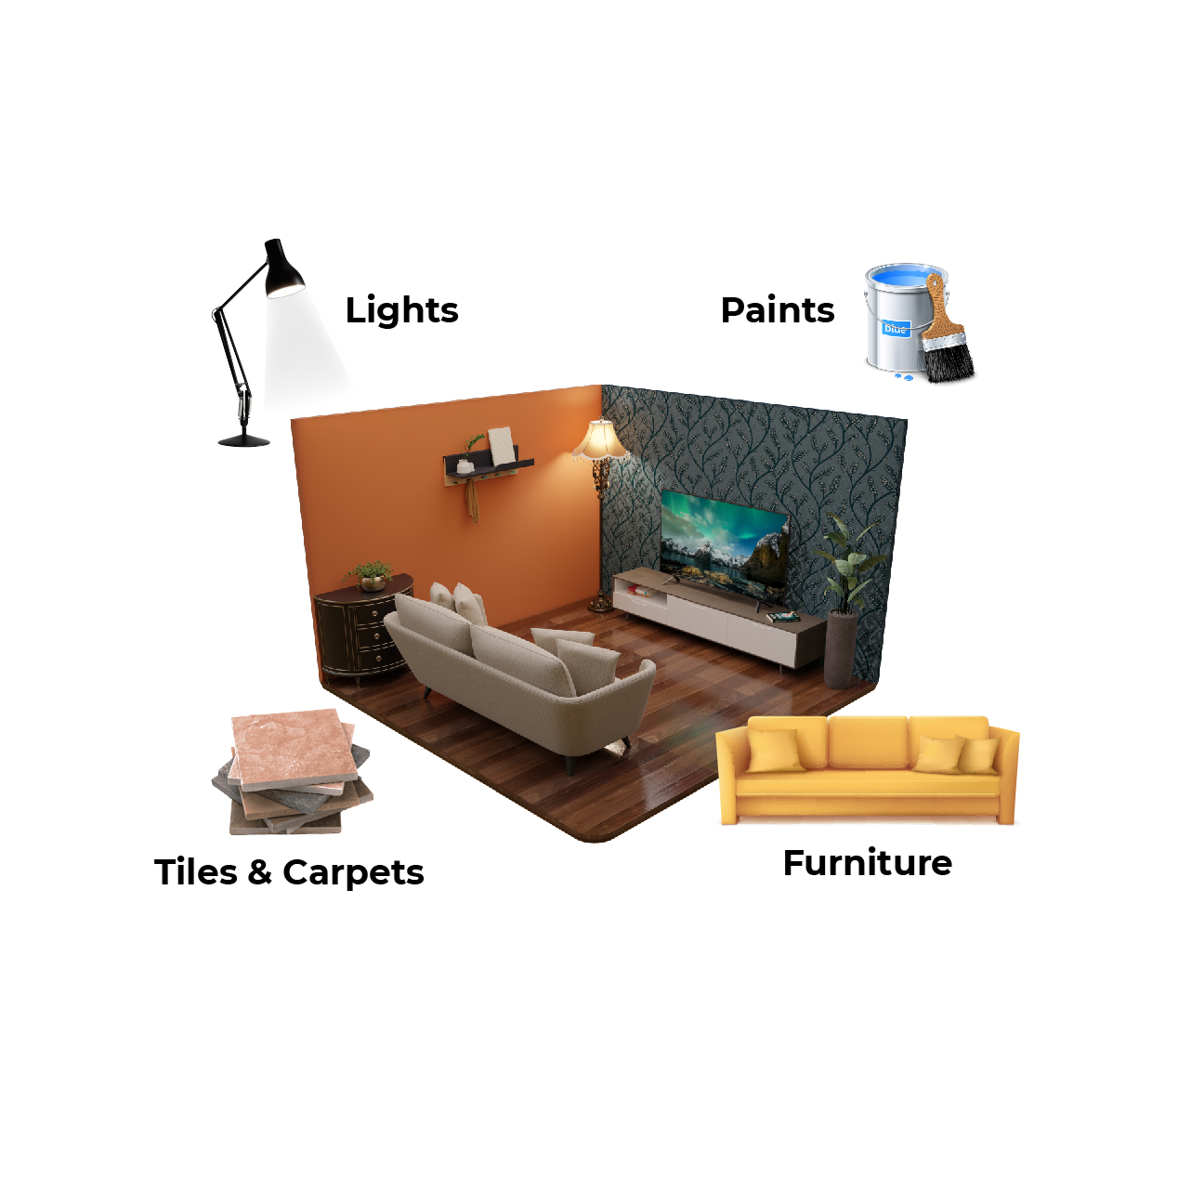
Market
Furniture: Produces and sells items like chairs, tables, and storage for homes and offices.
Lighting: Focuses on creating lamps, LEDs, and smart systems for various settings.
Paints: Produces decorative and industrial paints, with a focus on eco-friendly options.
Flooring: Manufactures and sells floor coverings like carpets, tiles, and hardwood for various spaces.

Slide 3
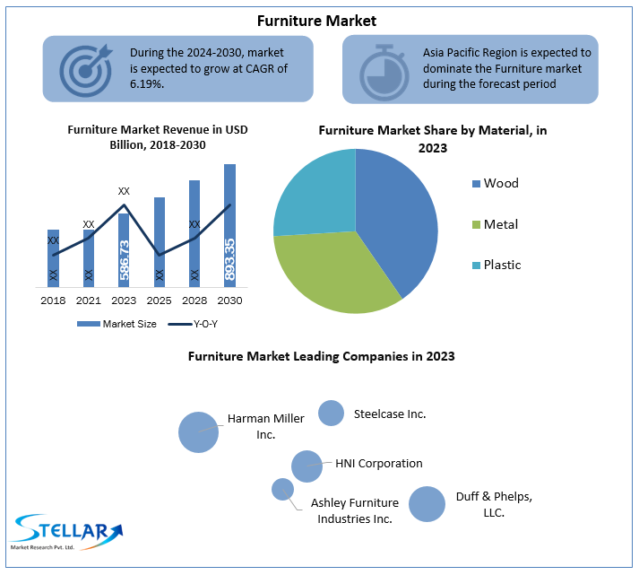
Overview Of The Market
Furniture Industry: The global furniture industry is experiencing steady growth, driven by rising disposable incomes, urbanization, and increasing demand for premium and multifunctional furniture. The market is currently dominated by residential furniture, with significant contributions from the office and luxury segments .

Slide 4
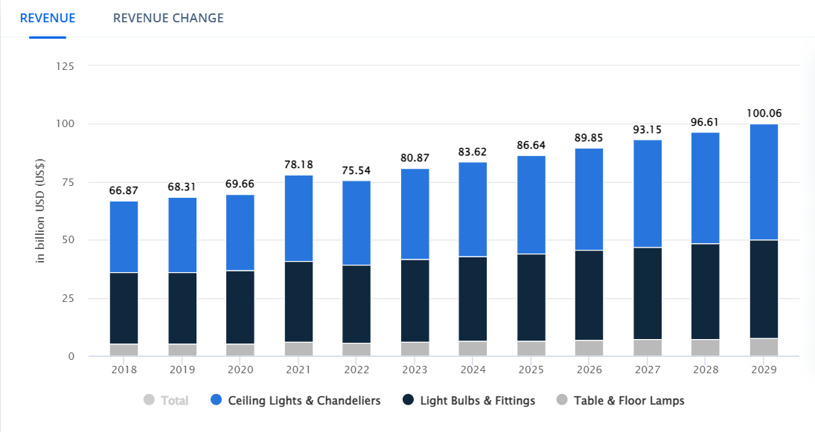
Lighting Industry: The lighting industry is rapidly evolving with the widespread adoption of energy-efficient LED technology. Smart lighting solutions are also gaining traction, particularly in residential and commercial sectors. Government incentives and sustainability initiatives are fueling the market's expansion.
Reference-https://www.statista.com/outlook/cmo/furniture/lamps-lighting/worldwide#revenue

Slide 5
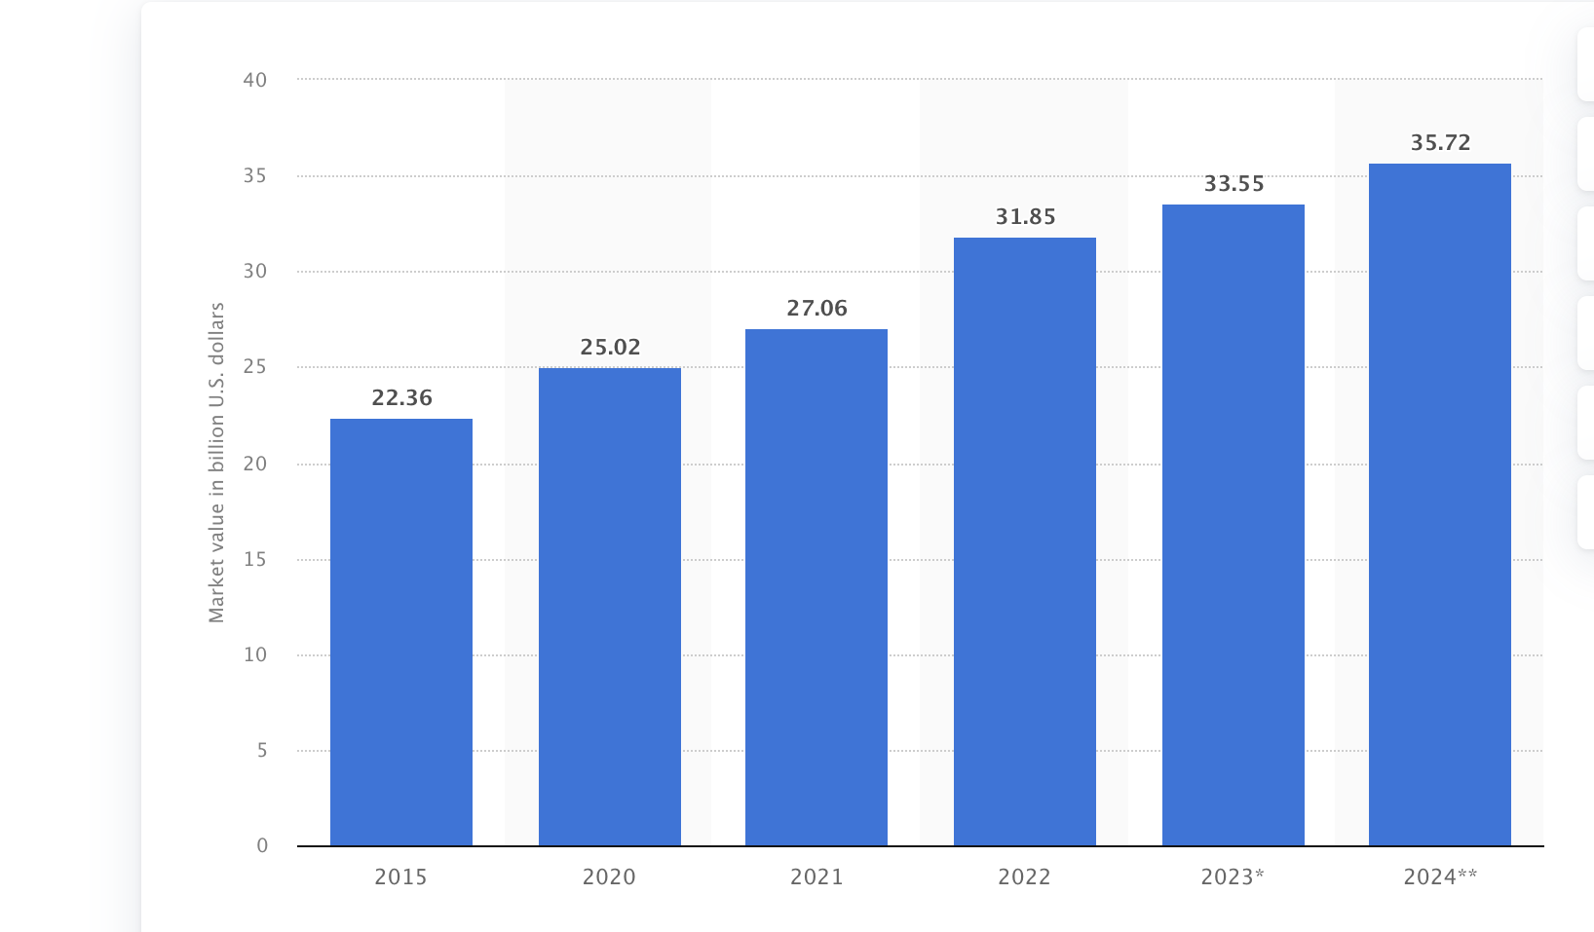
Paints Industry: The paints and coatings industry is robust, with the decorative segment leading the market. Growth is driven by increasing construction activities and the demand for eco-friendly and innovative products. The automotive and industrial segments also play a crucial role in market dynamics .
Refrence- https://www.statista.com/statistics/1261284/paint-and-coatings-market-value-us/

Slide 6
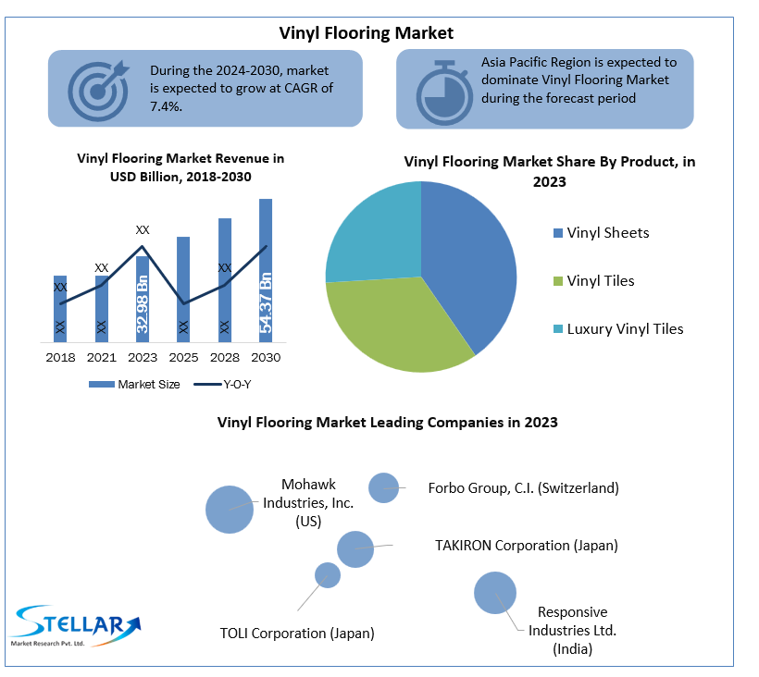
Flooring Industry: The flooring industry is witnessing substantial growth, particularly in tiles and vinyl segments, due to their durability and aesthetic appeal. The market is bolstered by increasing construction projects and renovation activities globally. Consumer preference for sustainable and easy-to-maintain flooring options is also driving growth .

Slide 7
Target Sector Size
GMV Worldwide
Flooring
Paints
$400
$170 Bn
Target
Furniture
Lighting
$600 Bn
$120 Bn

Slide 8
Market Segmentation
Furniture Industry
Key Segments
Residential
Largest segment, covering household furniture (e.g., bedroom, living room, dining room).
Luxury
High-end, premium furniture with bespoke designs.
Office
Includes office desks, chairs, storage units, etc.
Outdoor
Furniture for gardens, patios, and outdoor spaces.

Slide 9
Segment Sizes and Growth Rates
Residential Furniture
Market Size: $250 billion (2023)
Growth Rate: 4.5% CAGR (2024-2028)
Office Furniture
Market Size: $70 billion (2023)
Growth Rate: 3.2% CAGR (2024-2028)
Furniture Industry
Outdoor Furniture
Market Size: $18 billion (2023)
Growth Rate: 5.0% CAGR (2024-2028)
Luxury Furniture
Market Size: $35 billion (2023)
Growth Rate: 6.0% CAGR (2024-2028)

Slide 10
Market Trends
Furniture Industries
3D Visualization & Augmented Reality (AR)
Virtual Showrooms
3D Product Configurators
Customization
HD Rendering

Slide 11
Market Segmentation
Lighting Industry
Key Segments
Residential: Lighting solutions for homes, including LED bulbs, smart lighting.
Architectural: Specialty lighting for decorative and aesthetic purposes.
Commercial: Lighting for offices, retail spaces, and public buildings.
Industrial:
Lighting for factories, warehouses, and heavy-duty applications.

Slide 12
Segment Sizes and Growth Rates
LED Lighting
Market Size: $67 B
Growth Rate: 8.1% CAGR (2024-2028)
Commercial Lighting
Market Size: $60 billion (2023)
Growth Rate: 7.0% CAGR (2024-2028)
Furniture Industry
Industrial Lighting
Market Size: $35 billion (2023)
Growth Rate: 6.8% CAGR (2024-2028)
Architectural Lighting
Market Size: $15 billion (2023)
Growth Rate: 5.5% CAGR (2024-2028)

Slide 13
Market Trends
Lighting Industries
3D Visualization & Augmented Reality (AR)
Virtual Showrooms
Customization
3D Interactive features
Smart Lighting Solution

Slide 14
Market Segmentation
Paints Industry
Key Segments
Decorative Paints:
Used in residential and commercial buildings, includes interior and exterior paints.
Powder Coatings: Dry finishing process used for metal, aluminum, and other substrates.
Industrial Paints: Coatings for machinery, equipment, and other industrial applications.
Automotive Paints:
Paints used in vehicle manufacturing and maintenance.

Slide 15
Segment Sizes and Growth Rates
Decorative Paints
Market Size: $90 billion (2023)
Growth Rate: 5.2% CAGR (2024-2028)
Industrial Paints
Market Size: $50 billion (2023)
Growth Rate: 4.5% CAGR (2024-2028)
Furniture Industry
Automotive Paints
Market Size: $20 billion (2023)
Growth Rate: 6.0% CAGR (2024-2028)
Powder Coatings
Market Size: $14 billion (2023)
Growth Rate: 7.5% CAGR (2024-2028)

Slide 16
Market Trends
Paints Industries
Paint Calculator
3D Visualization
Customization
3D Interactive features

Slide 17
Market Segmentation
Flooring Industry
Key Segments
Residential Flooring:
Flooring for homes, including hardwood, laminate, vinyl, carpet, tile, and cork.
Luxury Vinyl Flooring :
High-end vinyl flooring options including glue-down, click-lock, and loose lay.
Tile Flooring:
Includes ceramic, porcelain, glass, and stone tiles.
Commercial Flooring:
Flooring for offices, retail spaces, and public buildings, including carpet tiles, vinyl, rubber, hardwood, and laminate.
Industrial Flooring:
Flooring solutions for factories, warehouses, and heavy-duty applications, including epoxy, polyurethane, concrete, and specialized industrial flooring.

